Slide 1
Review
HTML
<!DOCTYPE HTML>
<html>
<head>
<title>
<body>
<h1>
<p>
<b>
<u>
<i>

Slide 2
Styling in tag
Background Color
Color of text
Aligning

Slide 3
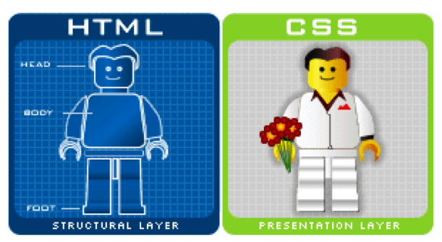

Slide 4

HTML Images

Slide 5

Images
Images can improve the design and the appearance of a web page.
Insert Image - Html code
Src - The src attribute specifies the URL (web address) of the image.
Alt - The alt attribute provides an alternate text for an image, if the user for some reason cannot view it.
Title – a text that pops up when you hover an image.

Slide 6

Src attribute
If an image is located in the same folder with web file.
<img src=“picture.jpg” >
If an image is located in the images folder in the current folder
<img src=“images/picture.jpg” >
picture.jpg is located in the folder one level up from the current folder
<img src=“../images/picture.jpg” >

Slide 7

CSS Style for Images
CSS Style | Description | Example
Width | Width of the image | Width: 200px;
Height | Height of the image | Height: 200px;
Float | Let the image float to the right or to the left of a text | Float: left; Float:right;
border | Border for image | Border: 1px;

Slide 8

CSS Style for Images
img{
width: 300px;
float: right;
}

Slide 9
Different Styles for different Images
html
<img class=“left” src=“picture.jpg”>
css
img.class{
width: 300px;
float: right;
}

Slide 10
Image as a background
body{
background-image: url(“picture.jpg”);
}
h1{
background-image: url(“picture.jpg”);
}

